Slide 1
Adjectives Review

Slide 3
Now it’s your turn! Look at the next pictures. Come up with 2 adjectives that could describe something in the picture. Write them on your white board.

Slide 4
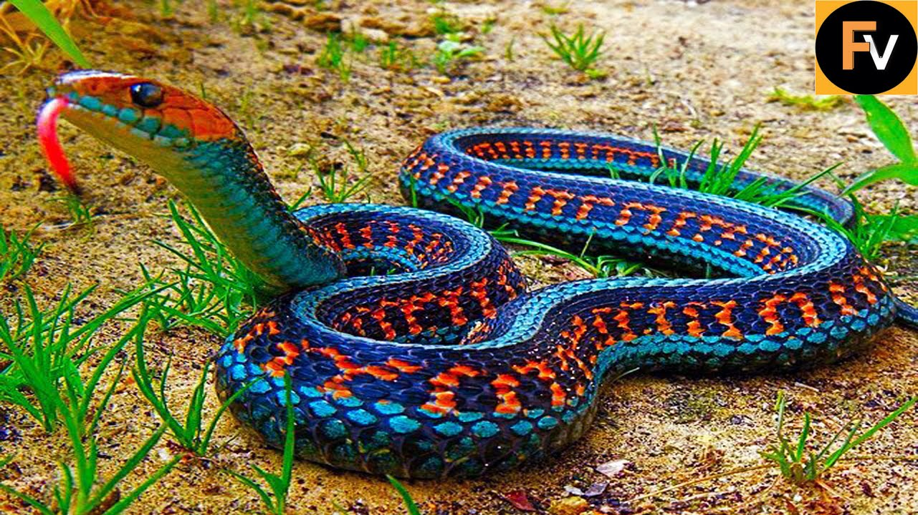

Slide 5
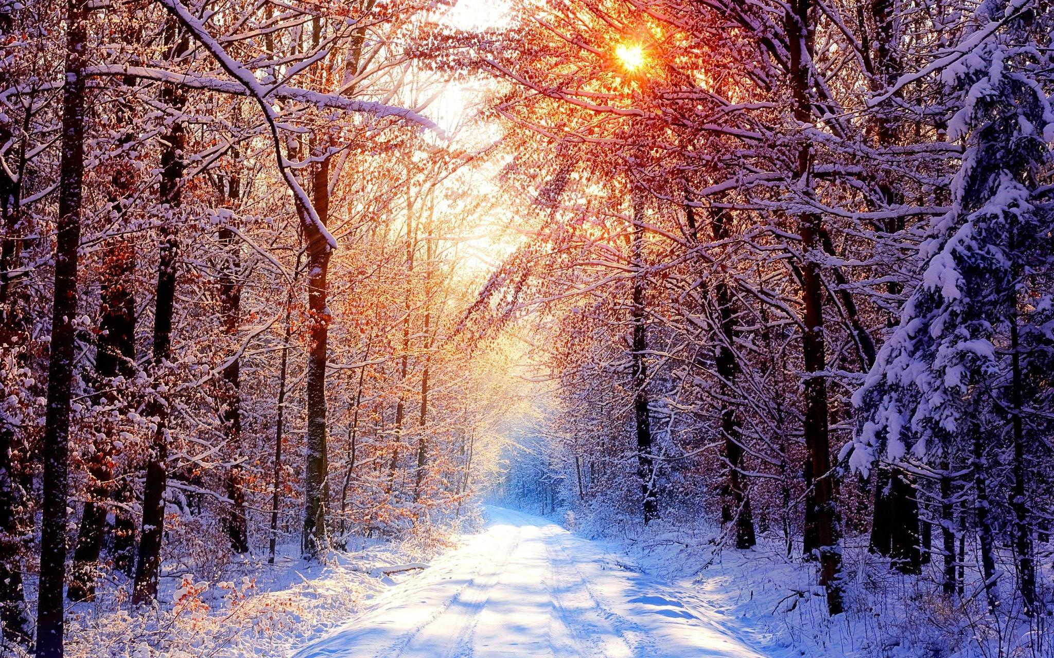

Slide 6
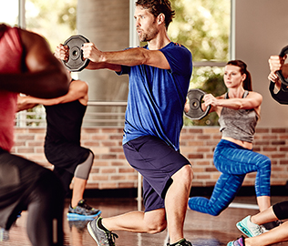

Slide 7
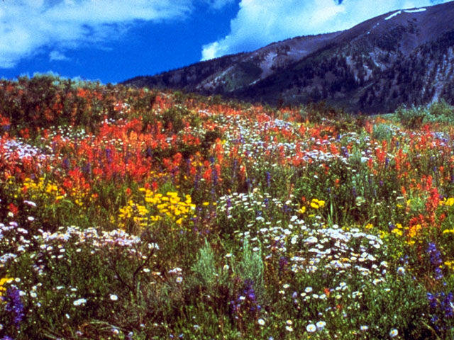

Slide 8
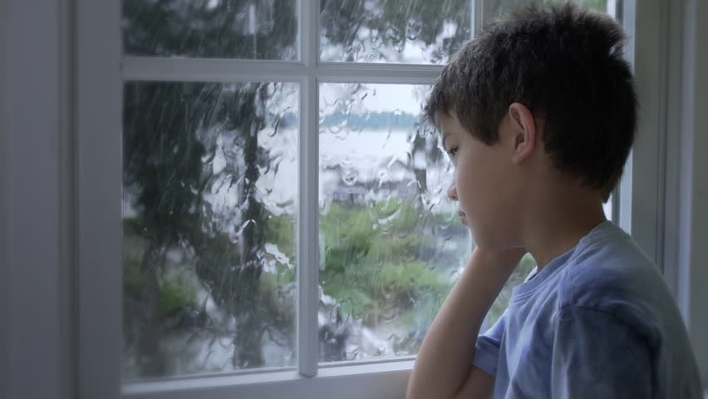

Slide 9
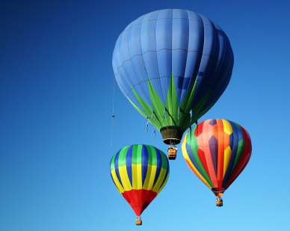

Slide 10
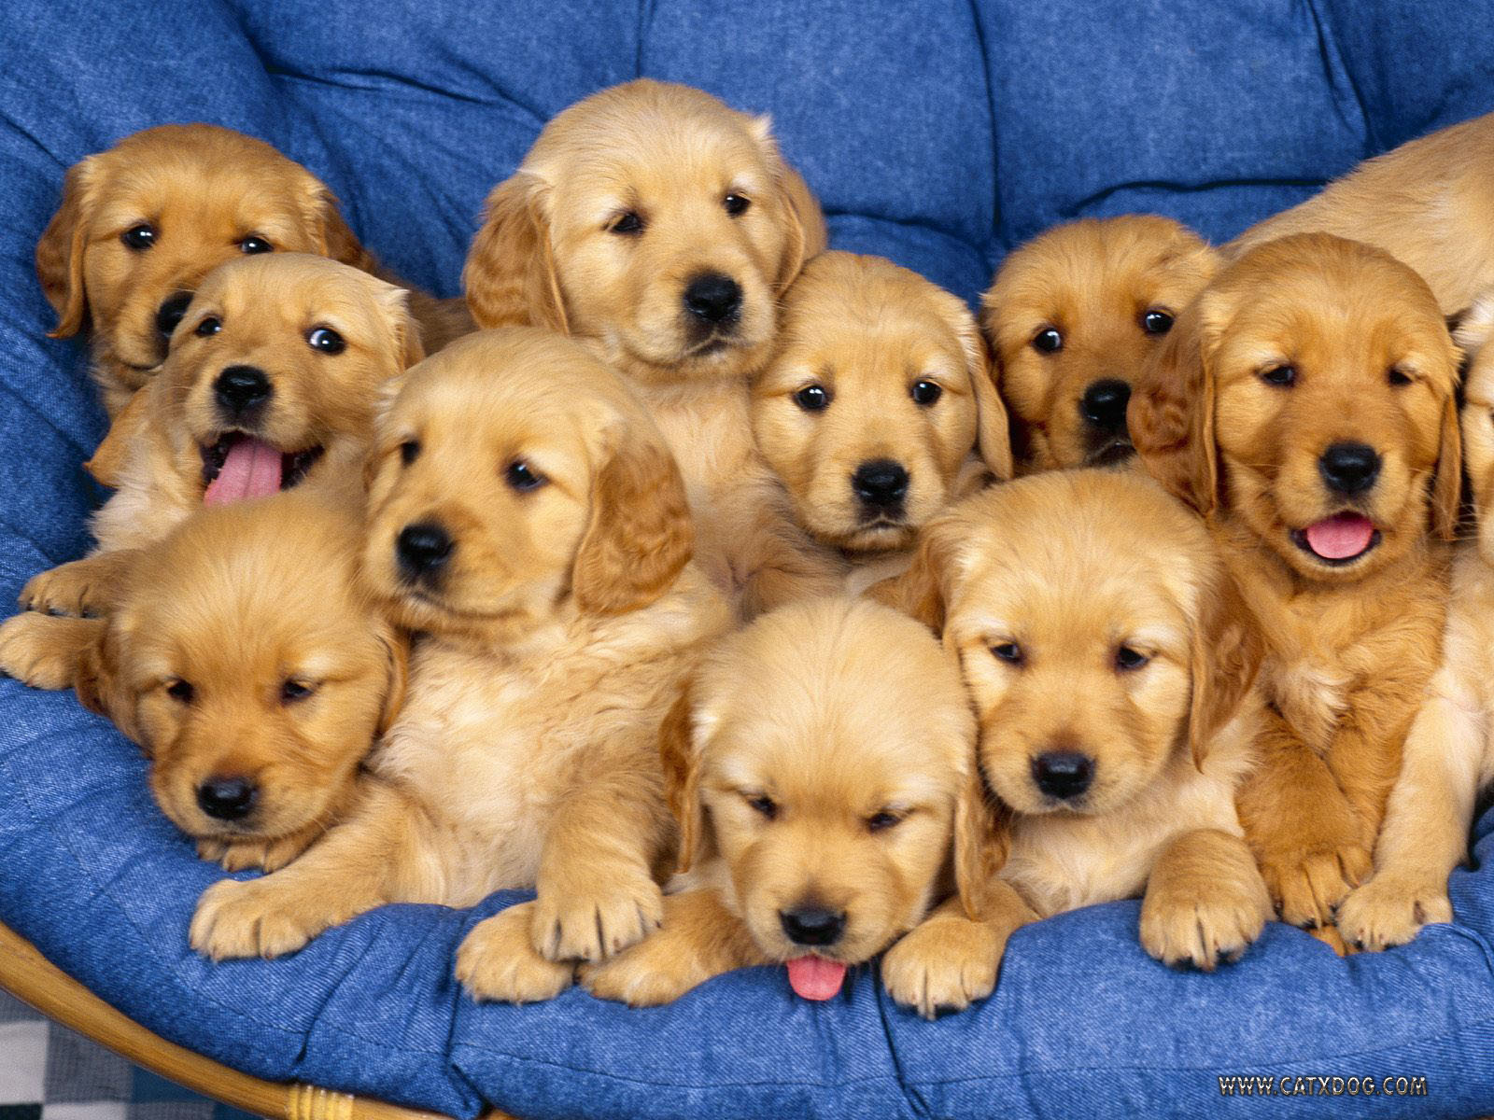

Slide 11
Adverbs Review

Slide 13
Now it’s your turn! Look at the next pictures. Come up with an adverb that could describe the action in the picture. Write them on your white board.

Slide 14
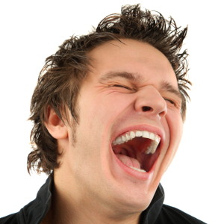
HOW is he laughing?

Slide 15
HOW OFTEN does the sun rise?

Slide 16
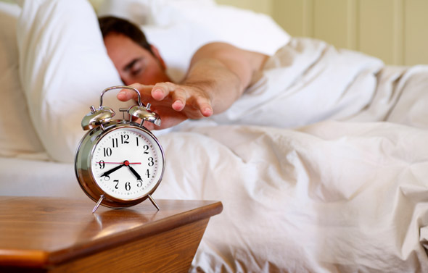
WHEN do we wake up?

Slide 17
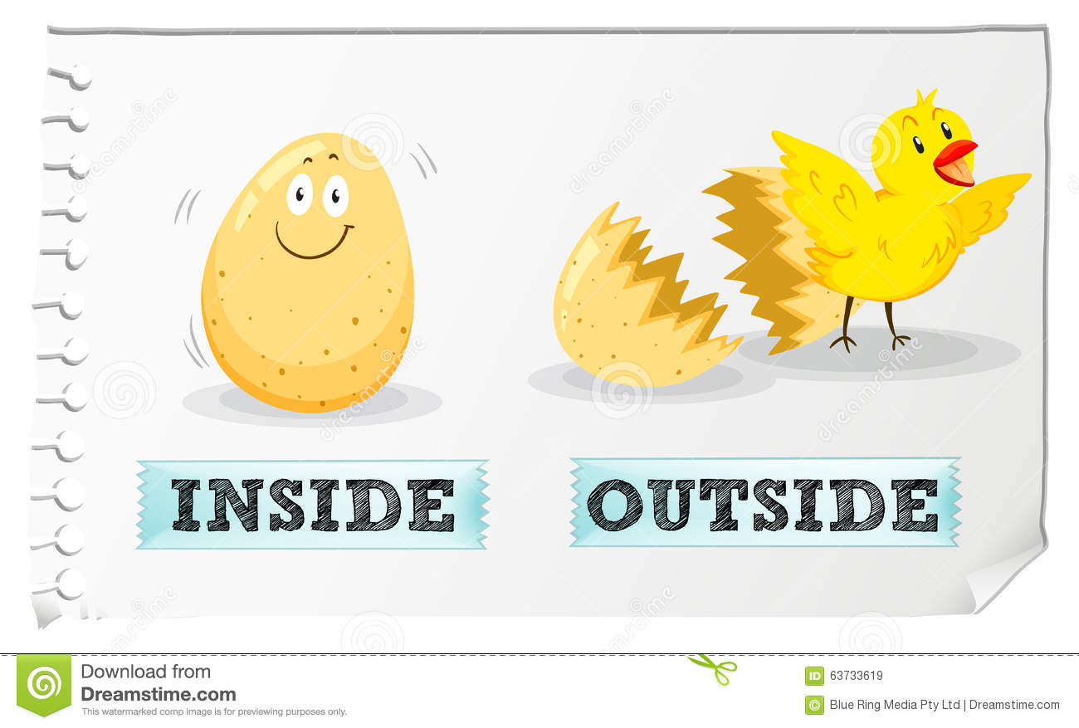
WHERE is the chicken first? Now WHERE is it?

Slide 18
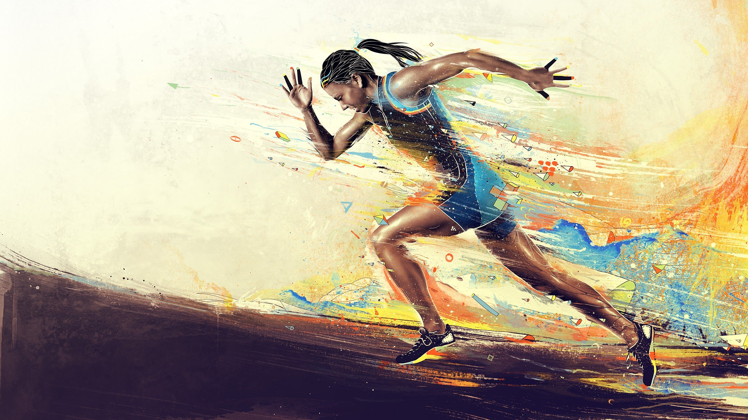
HOW is she running?

Slide 19
HOW should study in the library?

