Slide 1
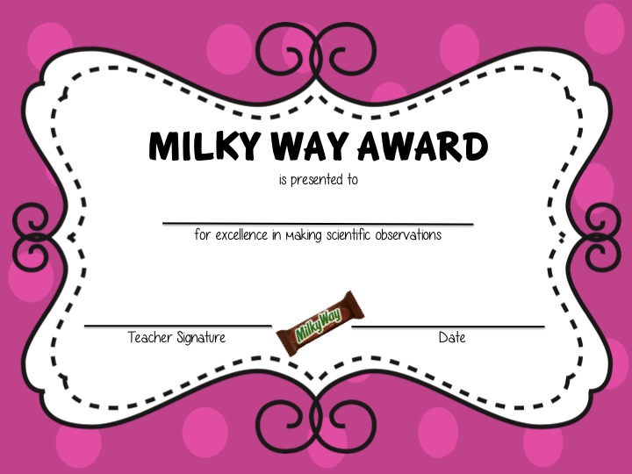
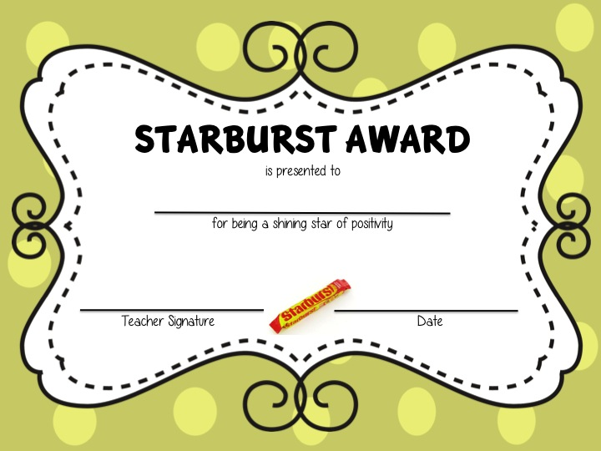
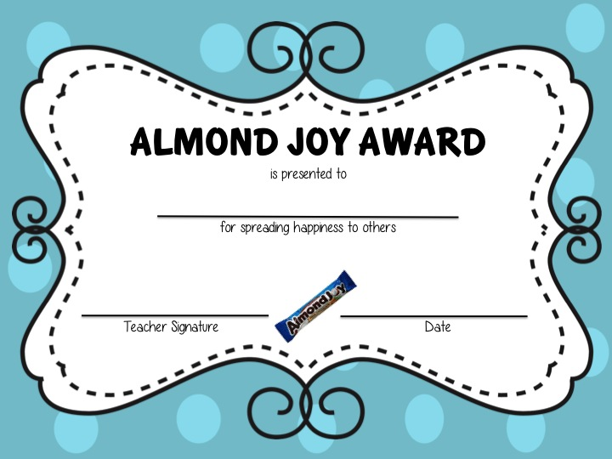
End-of-Year
Candy Bar Awards
30 different candy bar award categories
Editable, printable award slides
that you can customize for each student
as a fun end-of-year keepsake!
{Color and Black & White Versions Included}
by Grade School Cool

Slide 2
Thank You for Purchasing: End-of-Year Candy Bar Awards
Please follow me & be sure to check out all my materials at my TPT store:
http://www.teacherspayteachers.com/
Store/Grade-School-Cool
Cheers!
Grade School Cool
Copyright © 2013 Grade School Cool All rights reserved by author. Permission to copy for single classroom use only. Electronic distribution limited to single classroom use only. Not for public display.

Slide 3
List of Candy Bars Featured
3 Musketeers 11. Junior Mints 21. Payday
100 Grand 12. Kit Kat 22. Reece’s Cups
Almond Joy 13. Life Savers 23. Rolos
Baby Ruth 14. M&M’s 24. Skittles
Butterfinger 15. Mars 25. Snickers
Crunch 16. Mentos 26. Starburst
Dove Chocolate 17. Milky Way 27. SweeTarts
Hershey’s Bar 18. Mounds 28. Symphony
Hot Tamales 19. Mr. Goodbar 29. Twix
Jolly Rancher 20. Nerds 30. Whoppers

Slide 4
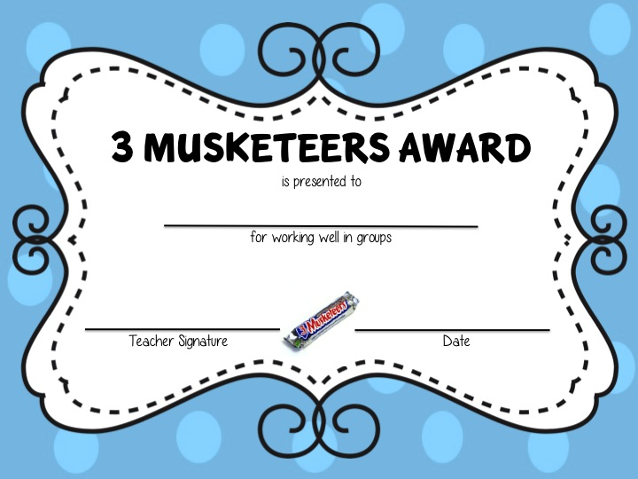
HOW TO EDIT AWARDS
Click right above this top line and a text box will appear. Then type in your student’s name.
Click right above this line and a text box will appear. Then type in the teacher’s name. (Or simply sign the printed form.)
Click right above this line and a text box will appear. Then type in the date.

Slide 5
30 End-of-Year Candy Bar Awards Editable, printable award slides that you can customize for each student as a fun end-of-year keepsake! Color Versions

Slide 6
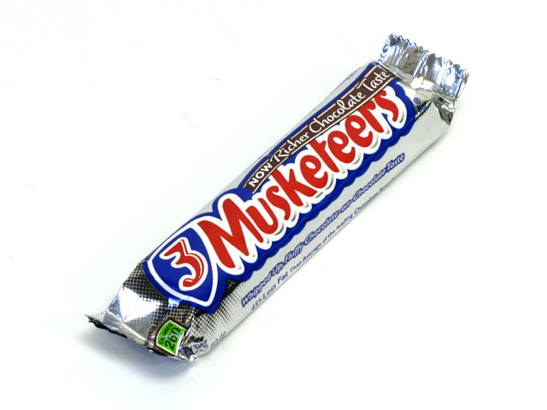
3 Musketeers Award
is presented to
for working well in groups
Teacher Signature
Date

Slide 7
100 Grand Award
is presented to
for being terrific at working with numbers
Teacher Signature
Date

Slide 8
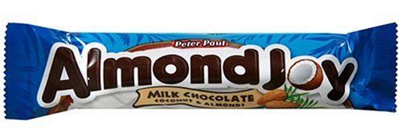
Almond Joy Award
is presented to
for spreading happiness to others
Teacher Signature
Date

Slide 9
Baby Ruth Award
is presented to
for being a star athlete
Teacher Signature
Date

Slide 10
Butterfinger Award
is presented to
for making creative masterpieces of art
Teacher Signature
Date

Slide 11
Crunch Award
is presented to
for coming through in crunch time
Teacher Signature
Date

Slide 12
Dove Chocolate Award
is presented to
for always being the peacemaker
Teacher Signature
Date

Slide 13
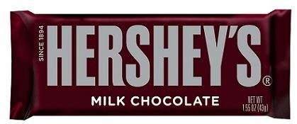
Hershey’s Bar Award
is presented to
for being kind to everyone
Teacher Signature
Date

Slide 14
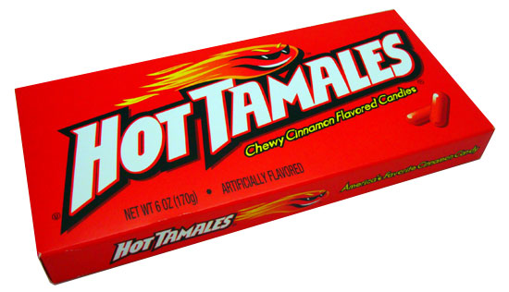
Hot Tamales Award
is presented to
for being quick on your feet
Teacher Signature
Date

Slide 15
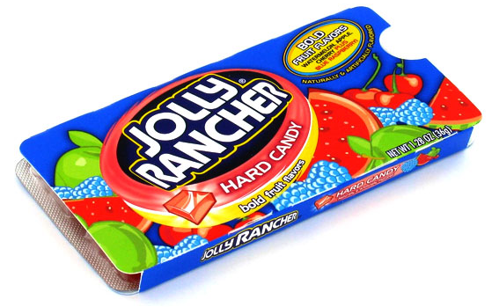
Jolly Rancher Award
is presented to
for always having a positive attitude
Teacher Signature
Date

Slide 16
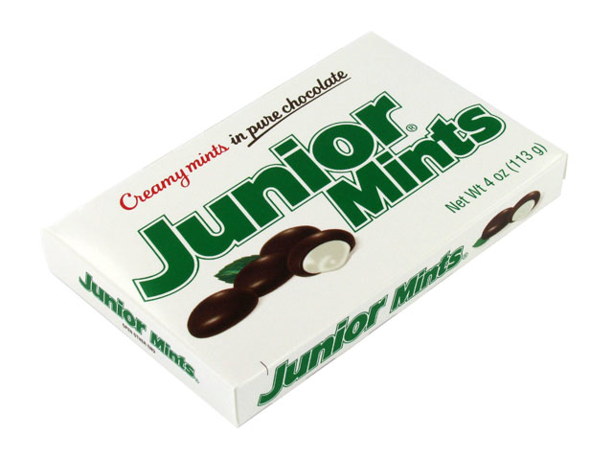
Junior Mints Award
is presented to
for always having refreshing ideas
Teacher Signature
Date

Slide 17
Kit Kat Award
is presented to
for the hard worker who deserves a break
Teacher Signature
Date

Slide 18
Life Savers Award
is presented to
for always helping others
Teacher Signature
Date

Slide 19
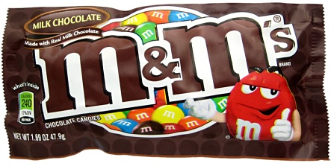
M&M’s Award
is presented to
for being excellent with letters
Teacher Signature
Date

Slide 20
Mars Award
is presented to
for having an out-of-this-world imagination
Teacher Signature
Date

Slide 21
Mentos Award
is presented to
for being a terrific mentor to others
Teacher Signature
Date

Slide 22
Milky Way Award
is presented to
for excellence in making scientific observations
Teacher Signature
Date

Slide 23
Mounds Award
is presented to
for always being mounds of fun
Teacher Signature
Date

Slide 24
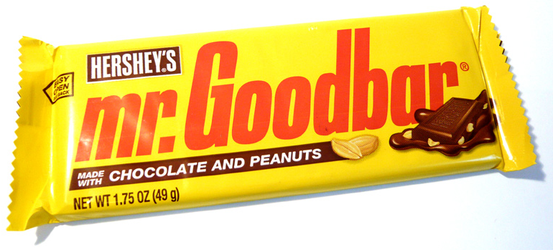
Mr. Goodbar Award
is presented to
for always being responsible and doing the right thing
Teacher Signature
Date

Slide 25
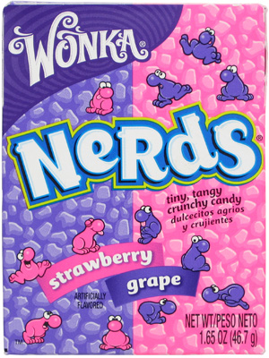
Nerds Award
is presented to
for overall strong academic performance
Teacher Signature
Date

Slide 26
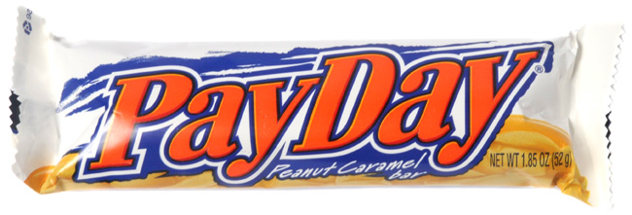
Payday Award
is presented to
for being a successful team leader
Teacher Signature
Date

Slide 27
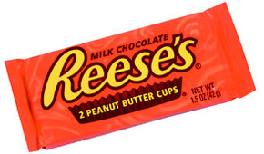
Reese’s Cups Award
is presented to
for exhibiting perfection
Teacher Signature
Date

Slide 28
Rolo Award
is presented to
for getting along with others by rolling with the flow
Teacher Signature
Date

Slide 29
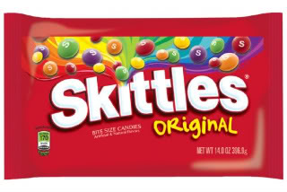
Skittles Award
is presented to
for having a colorful personality
Teacher Signature
Date

Slide 30
Snickers Award
is presented to
for always making others laugh
Teacher Signature
Date

Slide 31
Starburst Award
is presented to
for being a shining star of positivity
Teacher Signature
Date

Slide 32
SweeTarts Award
is presented to
for being extra sweet toward others
Teacher Signature
Date

Slide 33
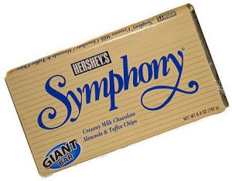
Symphony Award
is presented to
for displaying amazing musical talent
Teacher Signature
Date

Slide 34
Twix Award
is presented to
for being a sneaky trickster
Teacher Signature
Date

Slide 35
Whoppers Award
is presented to
for being an amazing storyteller
Teacher Signature
Date

Slide 36
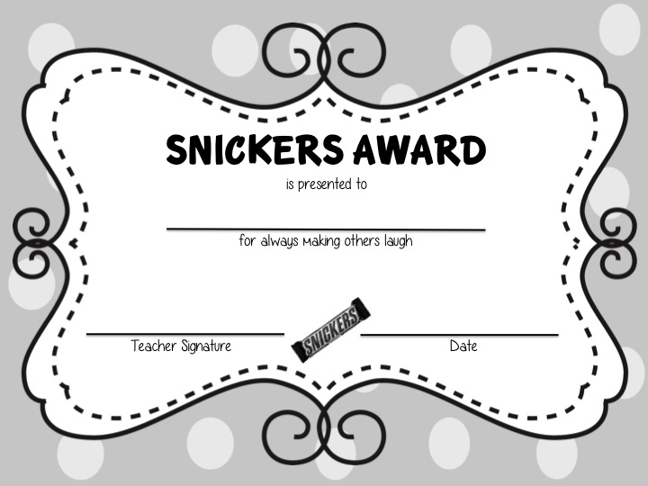
30 End-of-Year Candy Bar Awards Editable, printable award slides that you can customize for each student as a fun end-of-year keepsake! Black & White Versions

Slide 37
3 Musketeers Award
is presented to
for working well in groups
Teacher Signature
Date

Slide 38
100 Grand Award
is presented to
for being terrific at working with numbers
Teacher Signature
Date

Slide 39
Almond Joy Award
is presented to
for spreading happiness to others
Teacher Signature
Date

Slide 40
Baby Ruth Award
is presented to
for being a star athlete
Teacher Signature
Date

Slide 41
Butterfinger Award
is presented to
for making creative masterpieces of art
Teacher Signature
Date

Slide 42
Crunch Award
is presented to
for coming through in crunch time
Teacher Signature
Date

Slide 43
Dove Chocolate Award
is presented to
for always being the peacemaker
Teacher Signature
Date

Slide 44
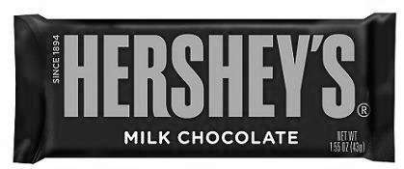
Hershey’s Bar Award
is presented to
for being kind to everyone
Teacher Signature
Date

Slide 45
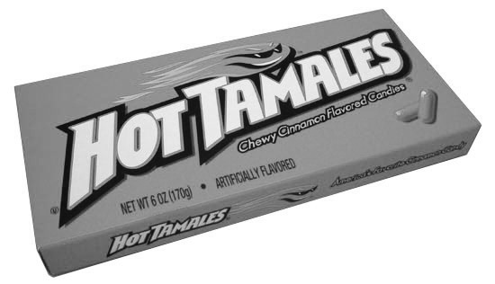
Hot Tamales Award
is presented to
for being quick on your feet
Teacher Signature
Date

Slide 46
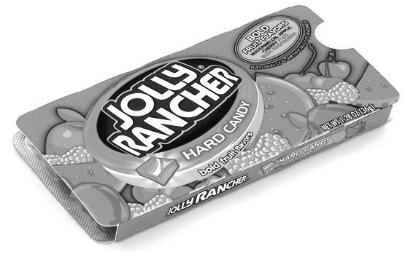
Jolly Rancher Award
is presented to
for always having a positive attitude
Teacher Signature
Date

Slide 47
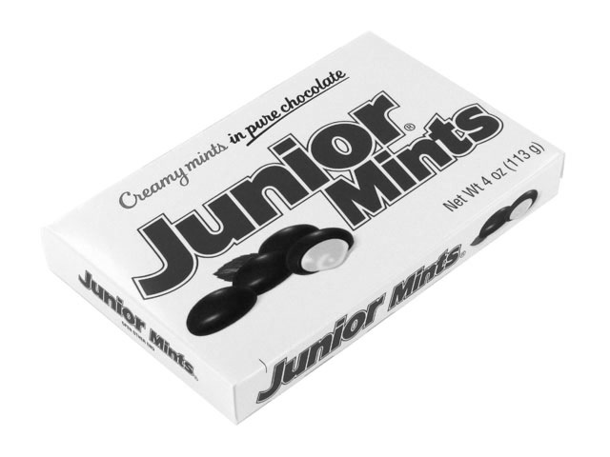
Junior Mints Award
is presented to
for always having refreshing ideas
Teacher Signature
Date

Slide 48
Kit Kat Award
is presented to
for the hard worker who deserves a break
Teacher Signature
Date

Slide 49
Life Savers Award
is presented to
for always helping others
Teacher Signature
Date

Slide 50
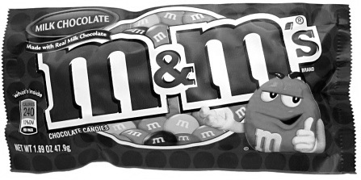
M&M’s Award
is presented to
for being excellent with letters
Teacher Signature
Date

Slide 51
Mars Award
is presented to
for having an out-of-this-world imagination
Teacher Signature
Date

Slide 52
Mentos Award
is presented to
for being a terrific mentor to others
Teacher Signature
Date

Slide 53
Milky Way Award
is presented to
for excellence in making scientific observations
Teacher Signature
Date

Slide 54
Mounds Award
is presented to
for always being mounds of fun
Teacher Signature
Date

Slide 55
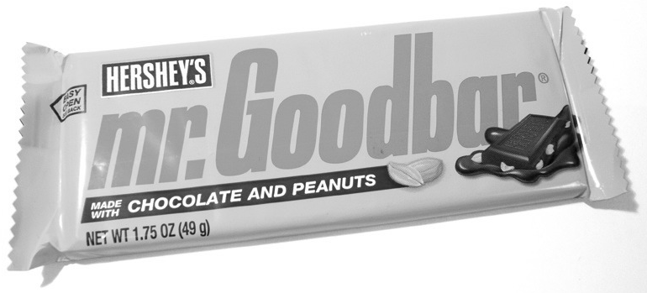
Mr. Goodbar Award
is presented to
for always being responsible and doing the right thing
Teacher Signature
Date

Slide 56
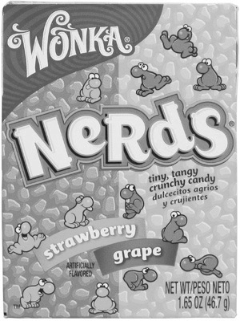
Nerds Award
is presented to
for overall strong academic performance
Teacher Signature
Date

Slide 57
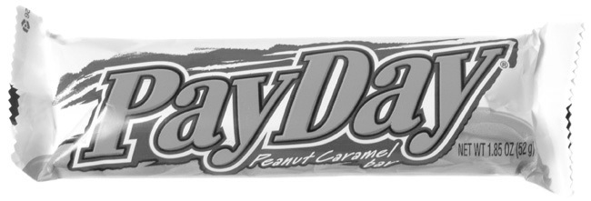
Payday Award
is presented to
for being a successful team leader
Teacher Signature
Date

Slide 58
Reese’s Cups Award
is presented to
for exhibiting perfection
Teacher Signature
Date

Slide 59
Rolo Award
is presented to
for getting along with others by rolling with the flow
Teacher Signature
Date

Slide 60
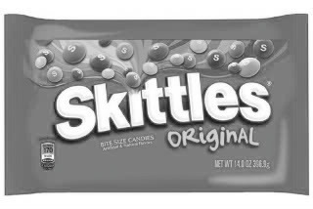
Skittles Award
is presented to
for having a colorful personality
Teacher Signature
Date

Slide 61
Snickers Award
is presented to
for always making others laugh
Teacher Signature
Date

Slide 62
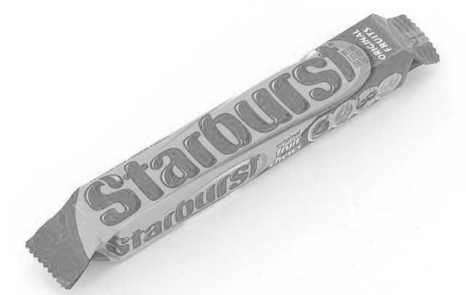
Starburst Award
is presented to
for being a shining star of positivity
Teacher Signature
Date

Slide 63
SweeTarts Award
is presented to
for being extra sweet toward others
Teacher Signature
Date

Slide 64
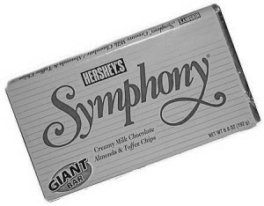
Symphony Award
is presented to
for displaying amazing musical talent
Teacher Signature
Date

Slide 65
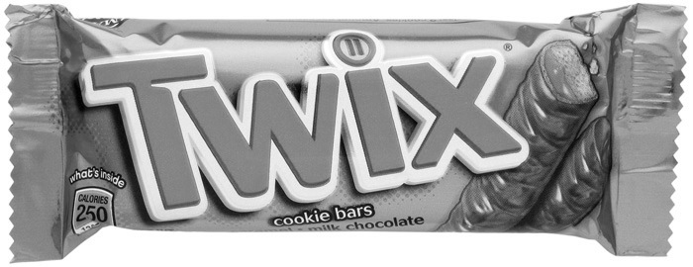
Twix Award
is presented to
for being a sneaky trickster
Teacher Signature
Date

Slide 66
Whoppers Award
is presented to
for being an amazing storyteller
Teacher Signature
Date

Slide 67
Thank You for Purchasing: End-of-Year Candy Bar Awards
I consistently update my items and post new products multiple times each week!
Please follow me & visit my TPT store again in the future for more great materials at
http://www.teacherspayteachers.com/Store/Grade-School-Cool
Backgrounds provided by Scrappin Doodles
Copyright © 2013 Grade School Cool All rights reserved by author. Permission to copy for single classroom use only. Electronic distribution limited to single classroom use only. Not for public display.

